Slide 1
COMP 1098
FINAL PROJECT
SAMRATH SINGH SAINI
200446420

Slide 2
LIBRARY MANAGEMENT PROJECT
FUNCTIONALITY INCLUDES
CRUD OPERATIONS
DATABASE CONNECTIONS
ERROR HANDLING
USE OF CLASSES AND METHODS
USING VARIOUS DATA TYPES AND FUNCTIONS AVAILABLE
USE OF FLAT DATA FILES

Slide 3
FUNCTIONALITY:
PROMPTING USER TO ADD FIRST NAME AND AGE
A LIST OF BESTSELLERS STORED IN AN ARRAY
A SWITCH STATEMENT THAT ACTS LIKE A MENU TO MAKE THE USER DECIDE BETWEEN CRUD FUNCTIONS
INFORMATION ABOUT LIBRARY MEMBERSHIP FEES
NOTIFYING THEM ABOUT THE DAYS LIBRARY IS OPENED OR CLOSED
TAKING THE CURRENT DAY AND CHECKING IT AGAINST THE DAYS THE LIBRARY IS OPENED AND TELLING THE USER THE SAME.

Slide 4
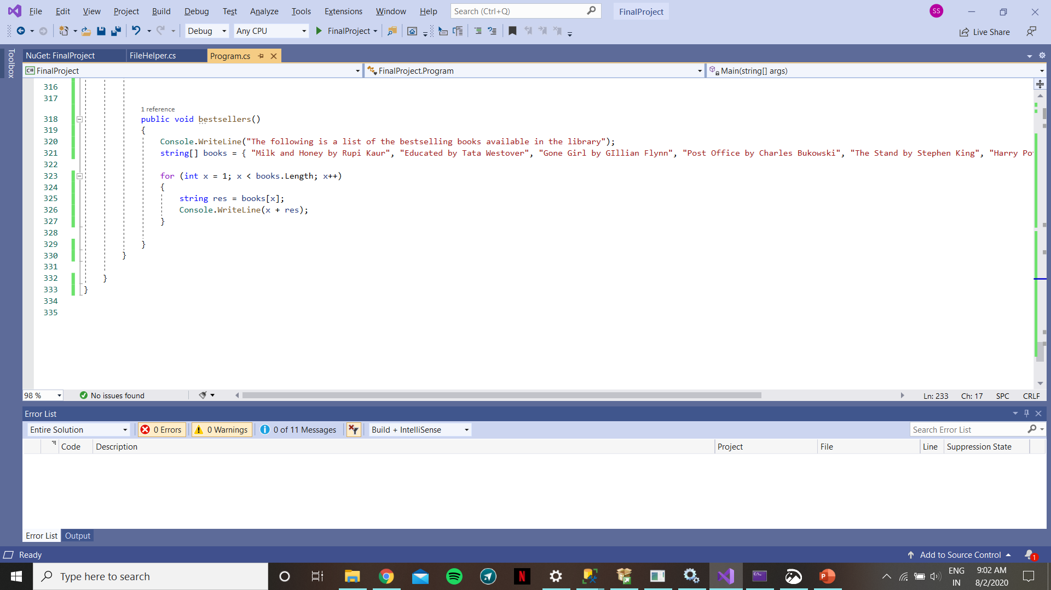
CODE SNIPPETS
METHOD TO DISPLAY BESTSELLERS

Slide 5
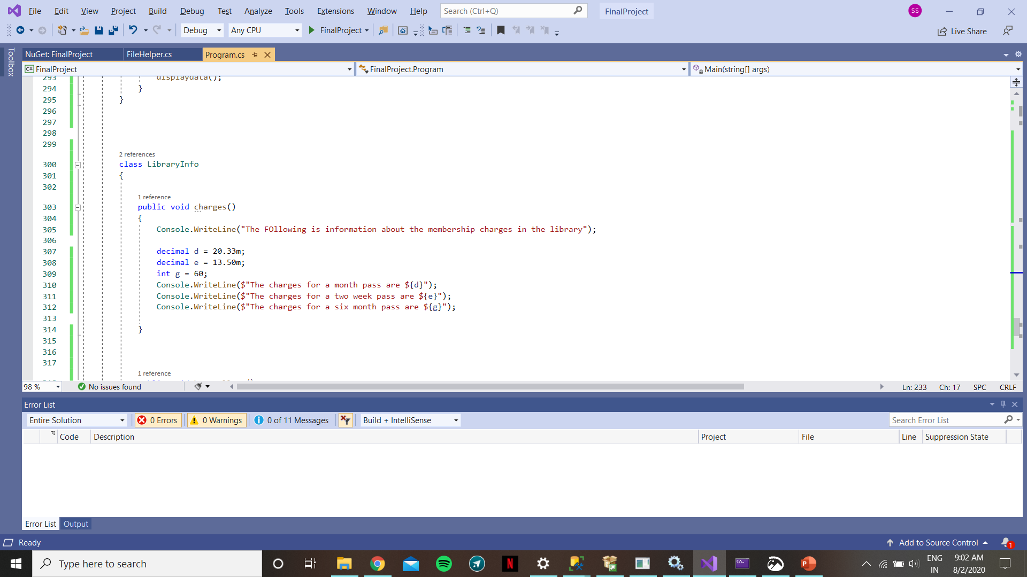
MEMBERSHIPS FEE INFO

Slide 6
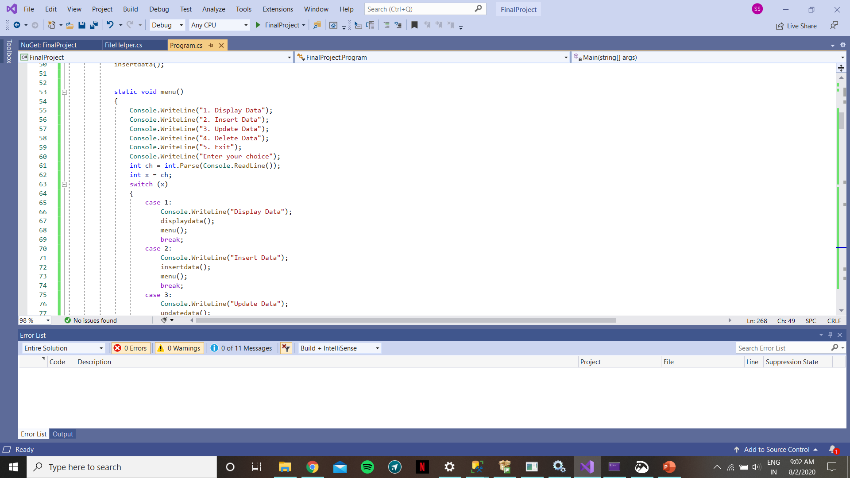
MENU STYLE SWITCH STATEMENT

Slide 7
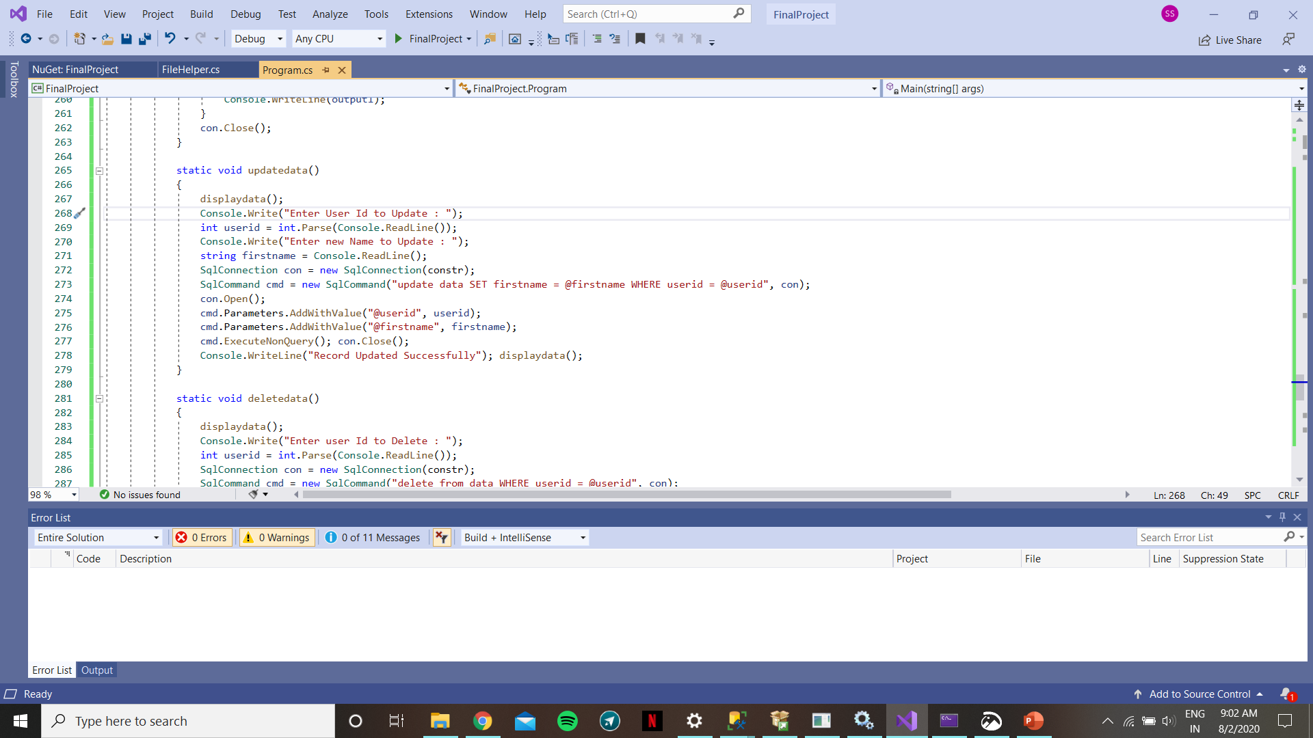
CRUD FUNCTIONS AND DATABASE CONNECTIVITY

Slide 8
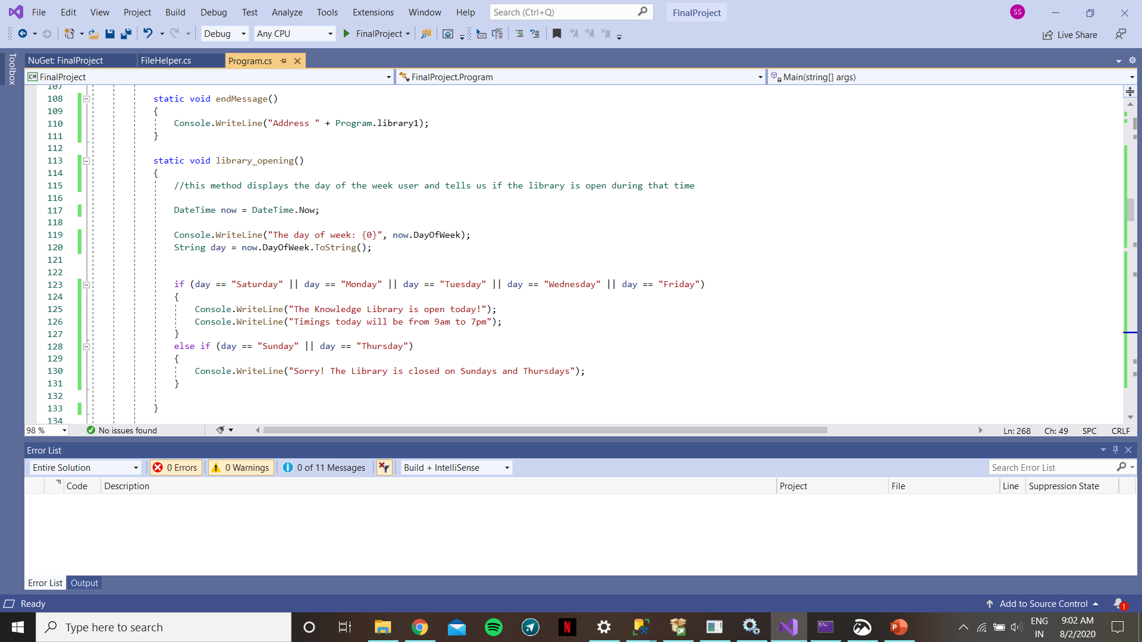
METHOD FOR TELLING USERS ABOUT OPEN AND CLOSE DAYS

Slide 9
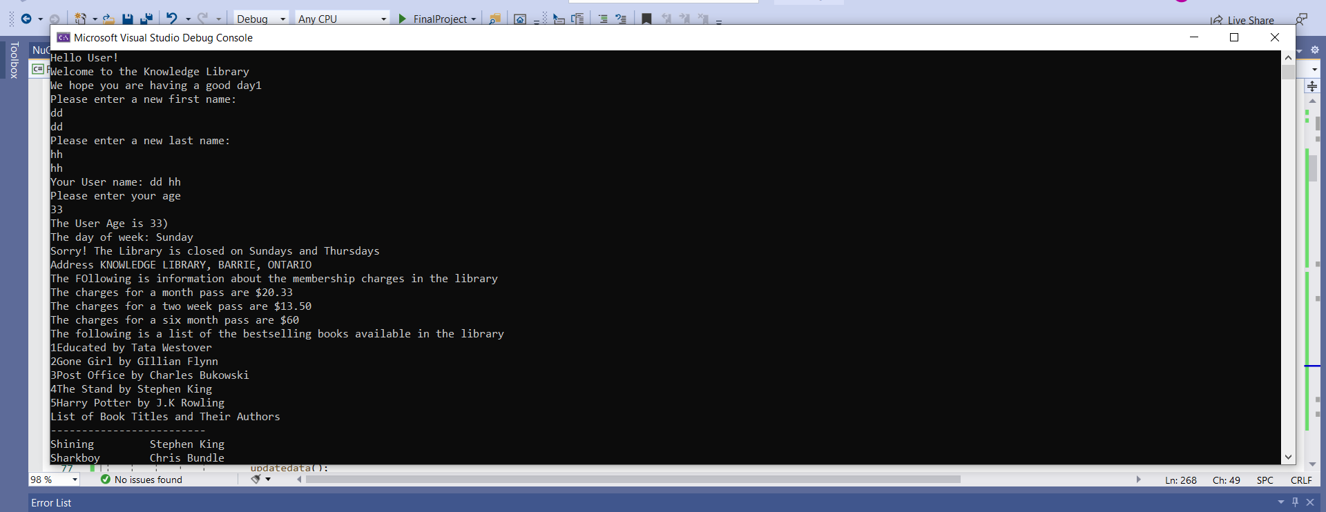
APPLICATION SCREENS

Slide 10
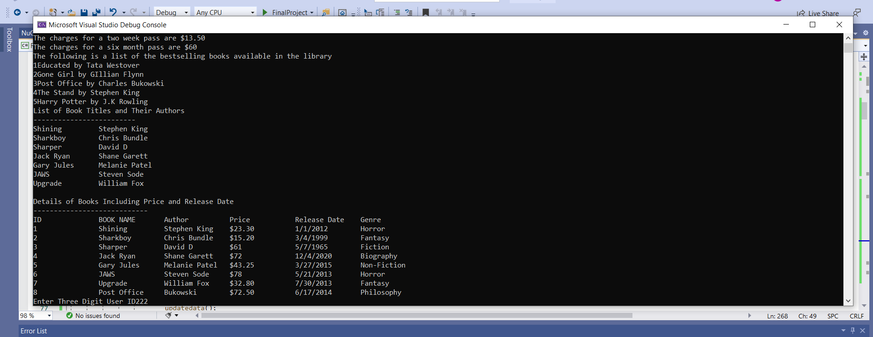
APPLICATION SCREENS

Slide 11
THANK YOU!
BY SAMRATH SINGH SAINI

